Slide 1
Statistics for Managers
Using Microsoft® Excel
5th Edition
Chapter 9 (Textbook Chapter 12)
Chi-Square Tests and Nonparametric Tests

Slide 2
Learning Objectives
In this chapter, you learn:
How and when to use the chi-square test for
contingency tables
  χ² test for the difference between two proportions
  χ² test for the difference in more than two proportions
  χ² test for independence
How and when to use nonparametric tests
  The Wilcoxon rank sum test for two population medians
  The Kruskal-Wallis H-test for multiple population medians

Slide 3
Contingency Tables
Contingency Tables
Useful in situations involving multiple
population proportions
Used to classify sample observations
according to two or more characteristics
Also called a cross-classification table.

Slide 4
Contingency Table Example
Hand Preference vs. Gender
Dominant Hand: Left vs. Right
Gender: Male vs. Female
2 categories for each variable, so the
table is called a 2 x 2 table
Suppose we examine a sample of
300 college students

Slide 5
Contingency Table Example
Sample results organized in a contingency table:
sample size = n = 300:
Hand Preference | Gender
 | Female | Male
Left | 12 | 24 | 36
Right | 108 | 156 | 264
 | 120 | 180 | 300
120 Females, 12 were left handed
180 Males, 24 were left handed

Slide 6
Contingency Table Example
H₀: π₁ = π₂ (Proportion of females who are left
handed is equal to the proportion of
males who are left handed)
H₁: π₁ ≠ π₂ (The two proportions are not the same
Hand preference is not independent
of gender)
If H₀ is true, then the proportion of left-handed females should be the same as the proportion of left-handed males.
The two proportions above should be the same as the proportion of left-handed people overall.

Slide 7
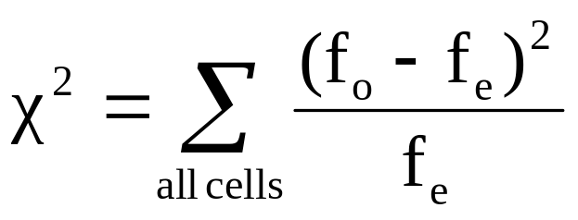
The Chi-Square Test Statistic
The Chi-square test statistic is:
where:
f_{o} = observed frequency in a particular cell
f_{e} = expected frequency in a particular cell if H₀ is true
χ² for the 2 x 2 case has 1 degree of freedom
Assumed: each cell in the contingency table has expected frequency of at least 5

Slide 8
The Chi-Square Test Statistic
The χ² test statistic approximately follows a chi-square distribution with one degree of freedom
Decision Rule:
If χ² > χ²_{U}, reject H₀, otherwise, do not reject H₀
α
0
χ²
Do not
reject H₀
Reject H₀
χ²_{U}

Slide 9
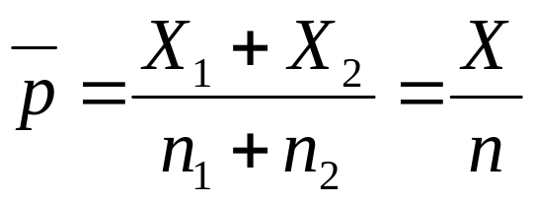
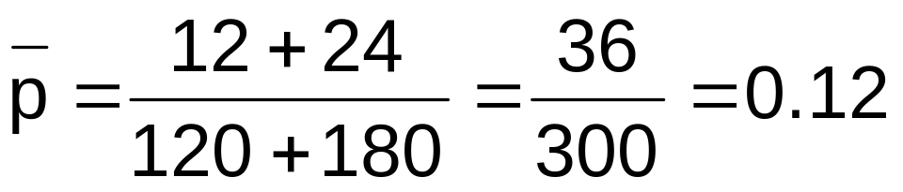
Computing the
Average Proportion
The average proportion is:
120 Females, 12 were left handed
180 Males, 24 were left handed
Here:
The proportion of left handers overall is 0.12, that is, 12%

Slide 10
Finding Expected Frequencies
To obtain the expected frequency for left handed
females, multiply the average proportion left handed (p)
by the total number of females
To obtain the expected frequency for left handed males,
multiply the average proportion left handed (p) by the
total number of males
If the two proportions are equal, then
P(Left Handed | Female) = P(Left Handed | Male) = .12
i.e., we would expect (.12)(120) = 14.4 females to be left handed
(.12)(180) = 21.6 males to be left handed

Slide 11
Observed vs. Expected Frequencies
Hand Preference | Gender
 | Female | Male
Left | Observed = 12 Expected = 14.4 | Observed = 24 Expected = 21.6 | 36
Right | Observed = 108 Expected = 105.6 | Observed = 156 Expected = 158.4 | 264
 | 120 | 180 | 300

Slide 12
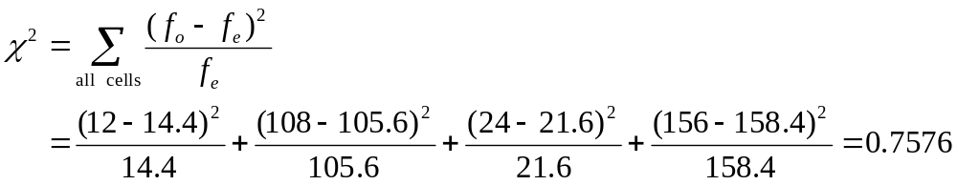
The Chi-Square Test Statistic
Hand Preference | Gender
 | Female | Male
Left | Observed = 12 Expected = 14.4 | Observed = 24 Expected = 21.6 | 36
Right | Observed = 108 Expected = 105.6 | Observed = 156 Expected = 158.4 | 264
 | 120 | 180 | 300
The test statistic is:

Slide 13
The Chi-Square Test Statistic
Decision Rule:
If χ² > 3.841, reject H₀, otherwise, do not reject H₀
Here,
χ² = 0.7576 < χ²_{U} = 3.841,
so you do not reject H₀ and conclude that there is insufficient evidence that the two proportions are different.
α=.05
0
χ²
Do not
reject H₀
Reject H₀
χ²_{U}=3.841

Slide 14
χ² Test for The Differences Among More Than Two Proportions
Extend the χ² test to the case with more than
two independent populations:
H₀: π₁ = π₂ = … = π_{c}
H₁: Not all of the π_{j} are equal (j = 1, 2, …, c)

Slide 15

The Chi-Square Test Statistic
The Chi-square test statistic is:
where:
f_{o} = observed frequency in a particular cell of the 2 x c table
f_{e} = expected frequency in a particular cell if H₀ is true
χ² for the 2 x c case has (2-1)(c-1) = c - 1 degrees of freedom
Assumed: each cell in the contingency table has expected
frequency of at least 1

Slide 16
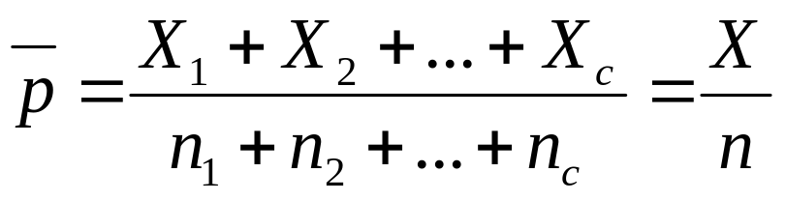
Computing the
Overall Proportion
The overall proportion is:
Expected cell frequencies for the c categories
are calculated as in the 2 x 2 case, and the
decision rule is the same:
Decision Rule:
If χ² > χ²_{U}, reject H₀, otherwise, do not reject H₀
Where χ²_{U} is from the chi-square distribution with c – 1 degrees of freedom

Slide 17
χ² Test with More Than Two Proportions: Example
The sharing of patient records is a
controversial issue in health care. A survey of
500 respondents asked whether they objected
to their records being shared by insurance
companies, by pharmacies, and by medical
researchers. The results are summarized on
the following table:

Slide 18
χ² Test with More Than Two Proportions: Example
Object to Record Sharing | Organization
 | Insurance Companies | Pharmacies | Medical Researchers
Yes | 410 | 295 | 335
No | 90 | 205 | 165

Slide 19
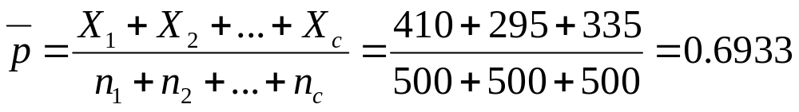
χ² Test with More Than Two Proportions: Example
The overall proportion is:
Object to Record Sharing | Organization
 | Insurance Companies | Pharmacies | Medical Researchers
Yes | f_{o} = 410 f_{e} = 346.667 | f_{o} = 295 f_{e} = 346.667 | f_{o} = 335 f_{e} = 346.667
No | f_{o} = 90 f_{e} = 153.333 | f_{o} = 205 f_{e} = 153.333 | f_{o} = 165 f_{e} = 153.333

Slide 20
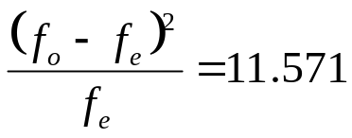
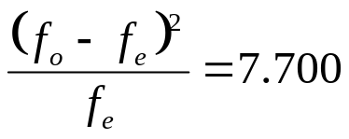
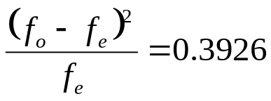
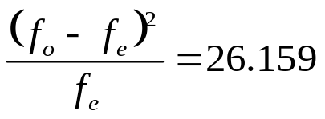
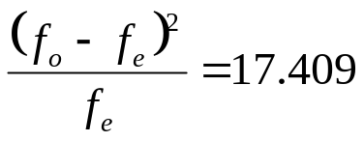
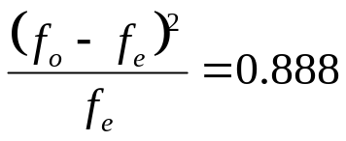
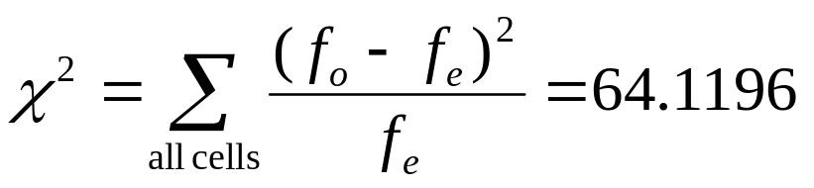
χ² Test with More Than Two Proportions: Example
Object to Record Sharing | Organization
 | Insurance Companies | Pharmacies | Medical Researchers
Yes
No
The Chi-square test statistic is:

Slide 21
χ² Test with More Than Two Proportions: Example
H₀: π₁ = π₂ = π₃
H₁: Not all of the π_{j} are equal (j = 1, 2, 3)
Decision Rule:
If χ² > χ²_{U}, reject H₀, otherwise, do not reject H₀
χ²_{U} = 5.991 is from the chi-square distribution with 2 degrees of freedom.
Conclusion: Since 64.1196 > 5.991, you reject H₀ and you conclude that at least one proportion of respondents who object to their records being shared is different across the three organizations

Slide 22
χ² Test of Independence
Similar to the χ² test for equality of more than two proportions, but extends the concept to contingency tables with r rows and c columns
H₀: The two categorical variables are independent
(i.e., there is no relationship between them)
H₁: The two categorical variables are dependent
(i.e., there is a relationship between them)

Slide 23
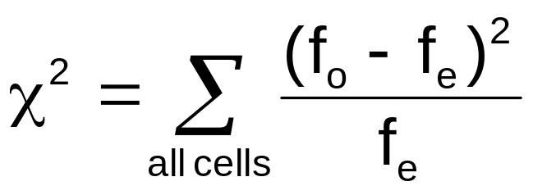
χ² Test of Independence
The Chi-square test statistic is:
where:
f_{o} = observed frequency in a particular cell of the r x c table
f_{e} = expected frequency in a particular cell if H₀ is true
χ² for the r x c case has (r-1)(c-1) degrees of freedom
Assumed: each cell in the contingency table has expected
frequency of at least 1

Slide 24
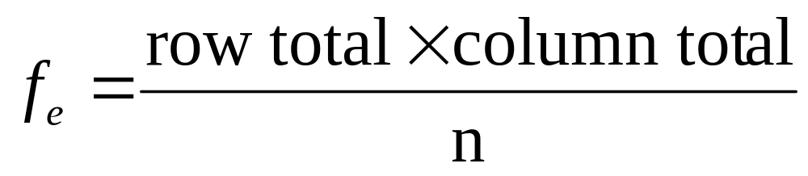
Expected Cell Frequencies
Expected cell frequencies:
Where:
row total = sum of all frequencies in the row
column total = sum of all frequencies in the column
n = overall sample size

Slide 25
Decision Rule
The decision rule is
If χ² > χ²_{U}, reject H₀, otherwise, do not reject H₀
Where χ²_{U} is from the chi-square distribution with (r – 1)(c – 1) degrees of freedom

Slide 26
Example: Test of Independence
The meal plan selected by 200 students is shown below:
Class Standing | Number of meals per week |  |  | Total
 | 20/week | 10/week | none
Fresh. | 24 | 32 | 14 | 70
Soph. | 22 | 26 | 12 | 60
Junior | 10 | 14 | 6 | 30
Senior | 14 | 16 | 10 | 40
Total | 70 | 88 | 42 | 200

Slide 27
Example: Test of Independence
The hypothesis to be tested is:
H₀: Meal plan and class standing are independent
(i.e., there is no relationship between them)
H₁: Meal plan and class standing are dependent
(i.e., there is a relationship between them)

Slide 28
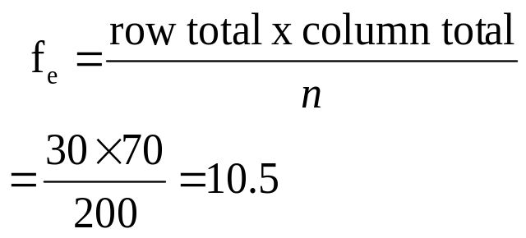
Example: Test of Independence
Expected cell frequencies if H₀ is true:
Example for one cell:
Class Standing | Number of meals per week |  |  | Total
 | 20/wk | 10/wk | none
Fresh. | 24.5 | 30.8 | 14.7 | 70
Soph. | 21.0 | 26.4 | 12.6 | 60
Junior | 10.5 | 13.2 | 6.3 | 30
Senior | 14.0 | 17.6 | 8.4 | 40
Total | 70 | 88 | 42 | 200

Slide 29
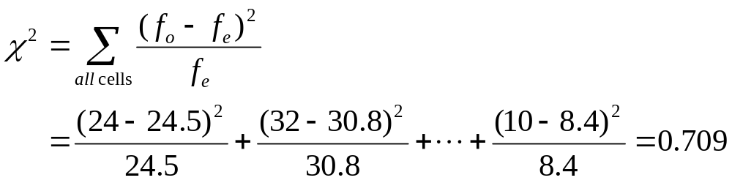
Example: Test of Independence
The test statistic value is:
χ²_{U} = 12.592 for α = .05 from the chi-square distribution with (4 – 1)(3 – 1) = 6 degrees of freedom

Slide 30
Example: Test of Independence
Decision Rule:
If χ² > 12.592, reject H₀, otherwise, do not reject H₀
Here,
χ² = 0.709 < χ²_{U} = 12.592,
so do not reject H₀
Conclusion: there is insufficient evidence that meal plan and class standing are related.
α=0.05
0
χ²
Do not
reject H₀
Reject H₀
χ²_{U}=12.592

Slide 31
Wilcoxon Rank-Sum Test
Test two independent population medians
Populations need not be normally distributed
Distribution free procedure
Used when only rank data are available

Slide 32
Wilcoxon Rank-Sum Test
Can use when both n₁ , n₂ ≤ 10
Assign ranks to the combined n₁ + n₂ sample
values
  If unequal sample sizes, let n₁ refer to smaller-
  sized sample
  Smallest value rank = 1, largest value rank =
  n₁+ n₂
  Assign average rank for ties
Sum the ranks for each sample: T₁ and T₂
Obtain test statistic, T₁ (from smaller sample)

Slide 33
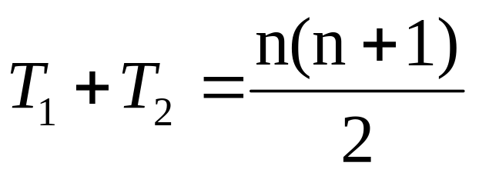
Checking the Rankings
The sum of the rankings must satisfy the
formula below
Can use this to verify the sums T₁ and T₂
where n = n₁ + n₂

Slide 34
Wilcoxon Rank-Sum Test
Hypothesis and Decision
M₁ = median of population 1; M₂ = median of population 2
Test statistic = T₁ (Sum of ranks from smaller sample)
Two-Tail Test
Left-Tail Test
Right-Tail Test
H₀: M₁ = M₂
H₁: M₁ ≠ M₂
H₀: M₁ ≥ M₂
H₁: M₁ < M₂
H₀: M₁ ≤ M₂
H₁: M₁ > M₂
Reject
Do Not Reject
Reject
Reject
Do Not Reject
Do Not Reject
Reject
T_{1L}
T_{1U}
T_{1L}
T_{1U}
Reject H₀ if T₁ ≤ T_{1L}
or if T₁ ≥ T_{1U}
Reject H₀ if T₁ ≤ T_{1L}
Reject H₀ if T₁ ≥ T_{1U}

Slide 35
Wilcoxon Rank-Sum Test
Example with Small Samples
Sample data are collected on the capacity
rates (% of capacity) for two factories.
Are the median operating rates for two
factories the same?
For factory A, the rates are 71, 82, 77, 94, 88
For factory B, the rates are 85, 82, 92, 97
Test for equality of the population medians
at the 0.05 significance level

Slide 36
Wilcoxon Rank-Sum Test
Example with Small Samples
Capacity |  | Rank
Factory A | Factory B | Factory A | Factory B
71 |  | 1
77 |  | 2
82 |  | 3.5
 | 82 |  | 3.5
 | 85 |  | 5
88 |  | 6
 | 92 |  | 7
94 |  | 8
 | 97 |  | 9
Rank Sums: |  | 20.5 | 24.5
Ranked
Capacity
values:
Tie in 3rd and 4th places

Slide 37
Wilcoxon Rank-Sum Test
Example with Small Samples
Factory B has the smaller sample size, so the test statistic is the sum of the Factory B ranks:
T₁ = 24.5
The sample sizes are:
n₁ = 4 (factory B)
n₂ = 5 (factory A)
The level of significance is α = .05

Slide 38
Wilcoxon Rank-Sum Test
Example with Small Samples
n₂ | α |  | n₁
 | One-Tailed | Two-Tailed | 4 | 5
4
5 | .05 | .10 | 12, 28 | 19, 36
 | .025 | .05 | 11, 29 | 17, 38
 | .01 | .02 | 10, 30 | 16, 39
 | .005 | .01 | --, -- | 15, 40
6
Lower and Upper Critical Values for T₁ from Appendix Table E.8:
T_{1L} = 11 and T_{1U} = 29

Slide 39
Wilcoxon Rank-Sum Test
Example with Small Samples
α = .05
n₁ = 4 , n₂ = 5
Test Statistic (Sum of ranks from smaller sample):
T₁ = 24.5
Decision:
Conclusion:
Two-Tail Test
H₀: M₁ = M₂
H₁: M₁ ≠ M₂
Do not reject at a = 0.05
Reject
Do Not Reject
Reject
T_{1L}=11
T_{1U}=29
There is not enough evidence to prove that the medians are not equal.
Reject H₀ if T₁ ≤ T_{1L} = 11
or if T₁ ≥ T_{1U} = 29

Slide 40
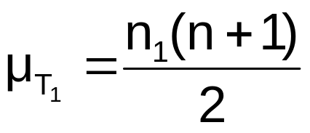
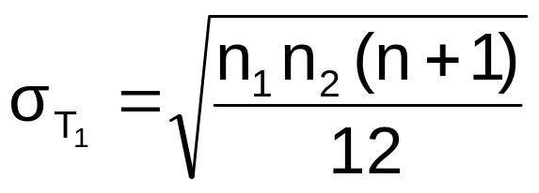
Wilcoxon Rank-Sum Test
Using Normal Approximation
For large samples, the test statistic T₁ is approximately
normal with mean and standard deviation:
  Must use the normal approximation if either n₁ or n₂ > 10
  Assign n₁ to be the smaller of the two sample sizes
  Can use the normal approximation for small samples

Slide 41
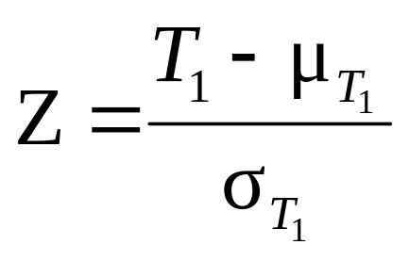
Wilcoxon Rank-Sum Test
Using Normal Approximation
The Z test statistic is
Where Z approximately follows a
standardized normal distribution

Slide 42
Wilcoxon Rank-Sum Test
Using Normal Approximation
Use the setting of the prior example:
The sample sizes were:
n₁ = 4 (factory B)
n₂ = 5 (factory A)
The level of significance was α = .05
The test statistic was T₁ = 24.5

Slide 43
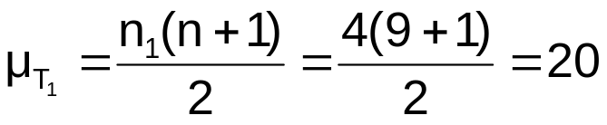
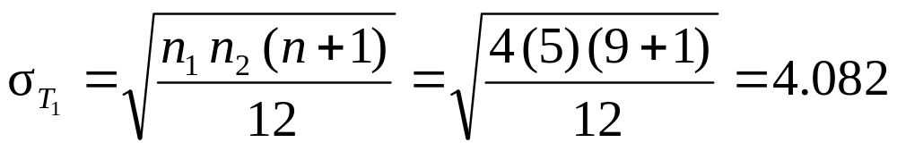
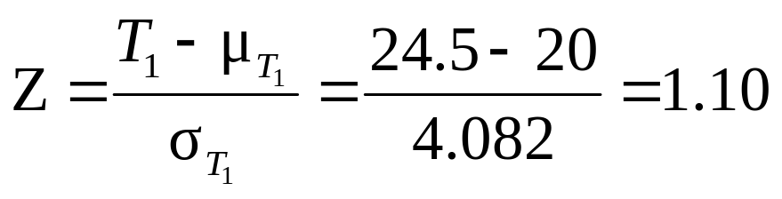
Wilcoxon Rank-Sum Test
Using Normal Approximation
The test statistic is
Z = 1.10 is less than the critical Z value of 1.96 (for α
= .05) so you do not reject H₀ – there is not sufficient
evidence that the medians are not equal

Slide 44
Kruskal-Wallis Rank Test
Tests the equality of more than 2 population medians
Use when the normality assumption for one-way
ANOVA is violated
Assumptions:
  The samples are random and independent
  variables have a continuous distribution
  the data can be ranked
  populations have the same variability
  populations have the same shape

Slide 45
Kruskal-Wallis Rank Test
Obtain overall rankings for each value
  In event of tie, each of the tied values gets the
  average rank
Sum the rankings for data from each of the c
groups
  Compute the H test statistic

Slide 46
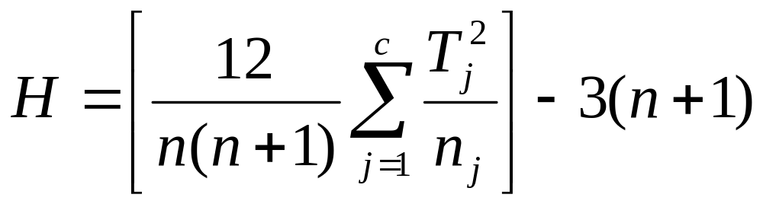
Kruskal-Wallis Rank Test
The Kruskal-Wallis H test statistic:
(with c – 1 degrees of freedom)
where:
n = total number of values over the combined samples
c = Number of groups
T_{j} = Sum of ranks in the j^{th} sample
n_{j} = Size of the j^{th} sample

Slide 47
Kruskal-Wallis Rank Test
Complete the test by comparing the calculated H
value to a critical χ² value from the chi-square
distribution with c – 1 degrees of freedom
Decision rule
  Reject H₀ if test statistic H >
  χ²_{U}
  Otherwise do not reject H₀
α
0
χ²
Do not
reject H₀
Reject H₀
χ²_{U}

Slide 48
Kruskal-Wallis Rank Test
Example
Do different branch offices have a different number of employees?
Office size (Chicago, C) | Office size (Denver, D) | Office size (Houston, H)
23 41 54 78 66 | 55 60 72 45 70 | 30 40 18 34 44

Slide 49
Kruskal-Wallis Rank Test
Example
Do different branch offices have a different
number of employees?
Office size (Chicago, C) | Ranking | Office size (Denver, D) | Ranking | Class size (Houston, H) | Ranking
23 41 54 78 66 | 2 6 9 15 12 | 55 60 72 45 70 | 10 11 14 8 13 | 30 40 18 34 44 | 3 5 1 4 7
 | Σ = 44 |  | Σ = 56 |  | Σ = 20

Slide 50
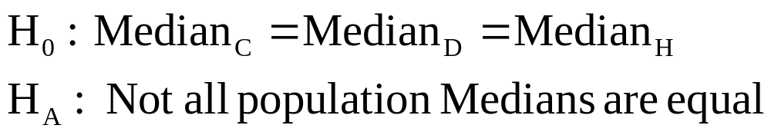
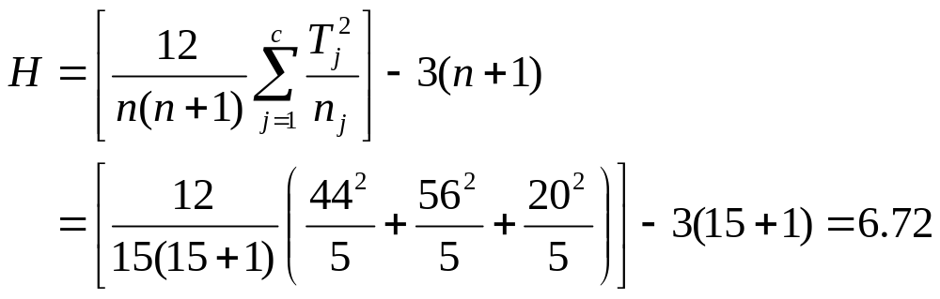
Kruskal-Wallis Rank Test
Example
The H statistic is

Slide 51
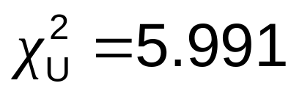
Kruskal-Wallis Rank Test
Example
Compare H = 6.72 to the critical value from the chi-
square distribution for 3 – 1 = 2 degrees of freedom
and α = .05:
Since H = 6.72 > ,
reject H₀
There is evidence of a difference in the population median number of employees in the branch offices

Slide 52
Chapter Summary
In this chapter, we have
Developed and applied the χ² test for the difference
between two proportions
Developed and applied the χ² test for differences in more
than two proportions
Examined the χ² test for independence
Used the Wilcoxon rank sum test for two population medians
  Small Samples
  Large sample Z approximation
Applied the Kruskal-Wallis H-test for multiple population
medians
  (End of Chapter 9)

